Slide 1
Speaker verification for drunk driving detection
Manavalan Kumaran (ML Intern - VA)
Mentors: Sebastian, Krithiga, Ayush, Senthil

Slide 2
Contents
Problem Statement
Background
Basics
Different mathematical approaches
Other methods
Literature Review
Dataset Description
Approach
Model Implementation
Results
Further steps
References

Slide 3
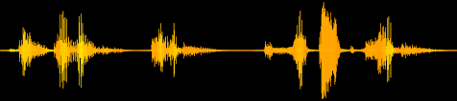
Problem Statement
Use speaker verification models to identify whether the authorized person giving the command, is sober or drunk, using voice samples
Helpful to identify if driver is drunk, and restrict access to car for such people

Slide 4
Basics
Enrollment: speaker’s voice is recorded and features are extracted from it (a voice template is created)
Verification: a speech sample or utterance is compared against available templates
Recognition: check if it satisfies a particular template (1:1 match)
Identification: check if there is a match with available templated (1:N match)
Text-dependent: same text is used for both enrollment and verification. Requires cooperation from speaker
Text-independent: text during enrollment and verification are different. Any phrase of the speaker can be used for verification

Slide 5
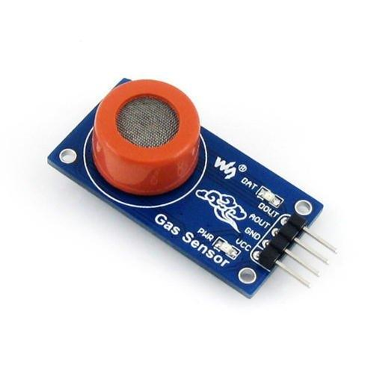
Other methods to detect alcohol detection
Vision – camera to detect movement of pupil
Detect alcohol concentration from sweat from palms
Sensors to detect alcohol intake from breath

Slide 6
Different mathematical approaches
GMM-UBM models
i-vector: generated from GMM (Gaussian Mixture Models) supervectors from a method called Joint Factor Analysis (JFA)
d-vector: generated from Deep Neural Networks (DNNs). Processes each individual frame. Cosine similarity is used for verification
x-vector: time delay neural network (TDNNs). Uses sliding window of frames as input + statistical pooling. PLDA for verification

Slide 7
The influence of alcoholic intoxication on the fundamental frequency of female and male speakers - Barbara Baumeister, Christian Heinrich and Florian Schiel
Frequency and IQR change when intoxicated, compared to sober.
Although a common trend can’t be ascertained, models for individual speakers can be developed.
Baumeister, Barbara, Christian Heinrich, and Florian Schiel. "The influence of alcoholic intoxication on the fundamental frequency of female and male speakers." The Journal of the Acoustical Society of America 132.1 (2012): 442-451.

Slide 8
On the Influence of Alcohol Intoxication on Speaker Recognition
Paper aims to identify if intoxicated voice samples affect the speaker verification system of sober samples
GMM based text independent speaker verification
16 LFCCs were extracted, and they added first-order derivatives, log energy and delta energy to create a 34-dimensional feature vector
Geiger, Jürgen, et al. "On the influence of alcohol intoxication on speaker recognition." Audio Engineering Society Conference: 53rd International Conference: Semantic Audio. Audio Engineering Society, 2014.

Slide 9
I’m Not Drunk, I’m Just Exhausted From Drinking All Night
LBG algorithm (a clustering algorithm) is used to break the sets into 100 codebooks. The centroids of the codebooks are stored.
Mel Frequency Cepstral Coefficients (MFCC’s) to characterize speech
Separated database into 4 sets: drunk males, sober males, drunk females, sober females
Vargo, Rob, et al. "I’m Not Drunk, I’m Just Exhausted From Drinking All Night." Group 4 (2006): 2.

Slide 10
Approach finalized to experiment
Start a model similar to the one in the paper “On the Influence of Alcohol Intoxication on Speaker Recognition” : use same features (16 LFCCs + first-order derivatives + mean RMSE)
Implement neural network, SVM and random forests, to see how different classification model perform

Slide 11
With a base neural network, started with both limited and full dataset
Tested 3 classification models - SVC, Random Forest, Neural Networks
Tested with different feature extractions - MFCC, LFCC and Mel
Tested with 16 vs 33 dimensional input vector
Tested with encoded input data, and compared with normal model - Logistic Regression, SVC, Random Forest

Slide 12
Dataset description
Different speakers uttering the same phrases, both drunk and intoxicated
20 speakers - uttering 42 phrases, both in intoxicated and sober state
840 voice samples for both drunk and intoxicated - 1680 total samples
Took intoxicated as class ‘1’ and sober as class ‘0’

Slide 13
Model Implementation details
16 LFCCs, the first-derivatives of those and mean RMSE → 33 features
3 classification models: neural networks, SVM and Random Forest
Neural network - 3 layers, 33 units in input layer, 16 units in 2nd layer, and a final output layer
SVM - rbf kernel
Random Forest - 100 estimators
(Standard configurations used for SVM and Random Forest)
Performance metric: Mean accuracy from Stratified K-fold and EER (Equal Error Rate)

Slide 14
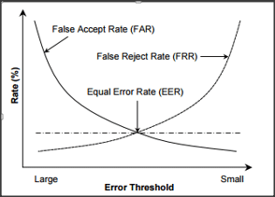
Equal Error Rate
Lower the EER, more optimal the system

Slide 15
MFCC vs LFCC vs Mel
Sounds generated by humans are determined by the shape of the vocal tract
The shape of vocal tract can be compared to the envelope of the short time power spectrum
MFCCs aim to capture this envelope
Further processing of Mel spectograms - MFCC
LFCC benefits more in female speech by better capturing the spectral characteristics in the high frequency region.

Slide 16
Summary of Results (Different features)
Neural network
 |  | Accuracy (Mean) | EER
16 features | Full dataset | 78.3% (2.4%) | 0.227
33 features | Full dataset | 78.54% (1.79%) | 0.203
Addition of features didn’t result in improvement of model performance

Slide 17
Summary of Results (Different models)
Feature extraction: Time: 11 min
 |  | Accuracy | EER | Time
Full dataset | SVM | 77.00% (2.31%) | 0.215 | 0.74 s
 | Random Forest | 79.78% (2.39%) | 0.206 | 3 s
 | Neural Network | 79.36% (2.16%) | 0.214 | 4 mins 10 s

Slide 18
Precision and Recall
 | Precision | Recall | F1-score
Neural network | 0.85 | 0.70 | 0.77
Random Forest | 0.79 | 0.78 | 0.78
SVC | 0.74 | 0.82 | 0.78

Slide 19
MFCC vs LFCC vs Mel
 | Accuracy (MFCC) | Accuracy (LFCC) | Accuracy (Mel)
SVM | 80.48% (3.13%) | 77.00% (2.31%) | 50.36% (2.62%)
Random Forests | 81.25% (2.13%) | 79.78% (2.39%) | 50.60% (2.10%)
Neural Networks | 82.98% (2.27%) | 79.36% (2.16%) | 49.52% (1.12%)
MFCC gives the best performance among these three
Other architectures have to be considered to improve performance further, since all models give the same result

Slide 20
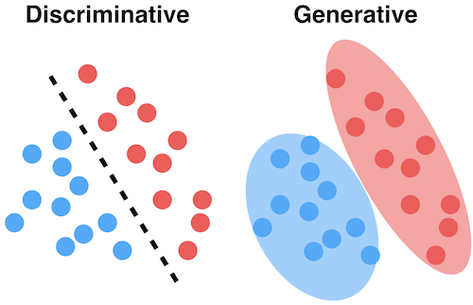
Discriminative vs generative models
Generative models can generate new data points, while discriminative cannot.

Slide 21
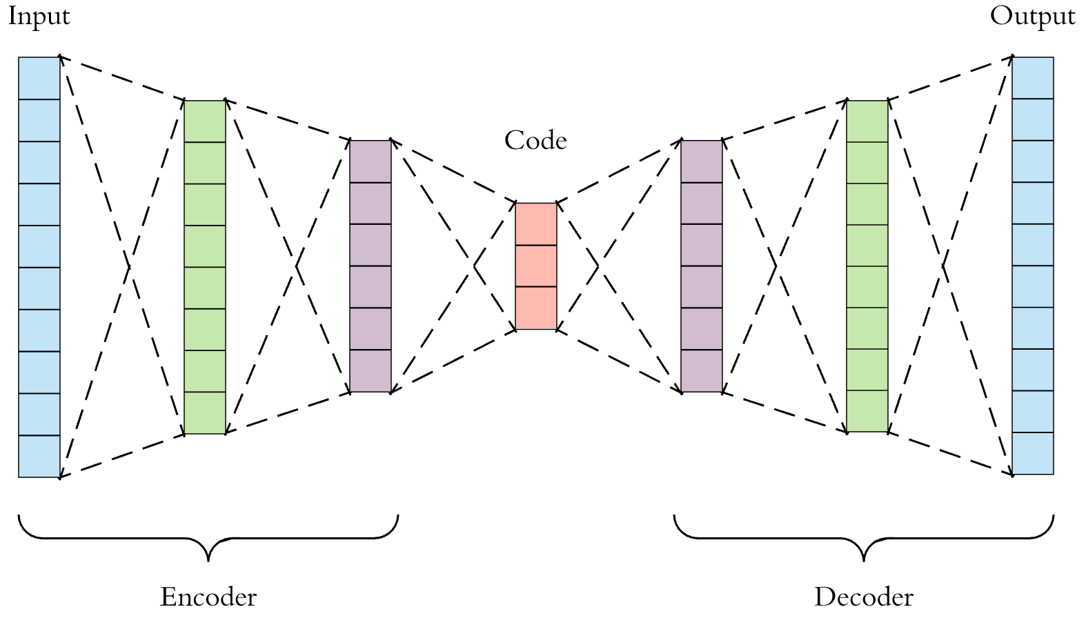
Autoencoders
Autoencoder: accepts input, compresses it and then recreates the original input
Variational Autoencoder: assumes the data follows an underlying distribution, and attempts to find its parameters
Can be used to generate new data related to original data
Encoder: creates a latent representation z for given datapoint x
Decoder: learns to recreate the data x, from a representation z
Encoder and decoders are neural networks

Slide 22
Implementation details & Results
Used only encoder part to get a representation of the data
Encoder learns from the data and creates a distribution, thus giving a more appropriate representation of the model, thus resulting in better features
 | Encoded | Normal
Logistic Regression | 67.20% (1.52%) | 68.27% (2.38%)
SVM | 69.23% (2.12%) | 80.48% (3.13%)
Random Forest | 75.06% (2.12%) | 81.25% (2.13%)
Neural Network | 71.13% (3.19%) | 82.98% (2.27%)

Slide 23
Autoencoders - Result
 | Encoded | Normal
Logistic Regression | 67.20% (1.52%) | 68.27% (2.38%)
SVM | 69.23% (2.12%) | 80.48% (3.13%)
Random Forest | 75.06% (2.12%) | 81.25% (2.13%)
Neural Network | 71.13% (3.19%) | 82.98% (2.27%)
Performance of model deteriorates with encoded features

Slide 24
Further steps
Read about alcohol intoxication, and see what parts of voice changes
See what features can be extracted, to capture those differences (so as to improve the features)
Look at generative models, so that we can also generate new data points
Train with different models to improve the results (existing advanced speaker verification models)

Slide 25
References
The influence of alcoholic intoxication on the fundamental frequency of female and male speakers - Barbara Baumeister, Christian Heinrich and Florian Schiel
On the Influence of Alcohol Intoxication on Speaker Recognition
I’m Not Drunk, I’m Just Exhausted From Drinking All Night
https://machinelearningmastery.com/evaluate-performance-deep-learning-models-keras/
https://freesound.org/people/drmier/sounds/221357/
https://gist.github.com/RicherMans/dc1b50dd8043cee5872e0b7584f6202f
https://github.com/YuanGongND/python-compute-eer
https://www.indiamart.com/proddetail/mq-3-alcohol-gas-sensor-module-23700698330.html
http://practicalcryptography.com/miscellaneous/machine-learning/guide-mel-frequency-cepstral-coefficients-mfccs/

Slide 26
Thank you

